Slide 1

Password Hashing and Cracking in Python
Mateusz Ziobrowski
C00284487
Michal Grzanka
C00286348

Slide 2

Introduction
This project demonstrates password security concepts such as, secure hashing and password cracking techniques.
Key Features:
Password hashing with bcrypt and SHA-256.
Brute-force cracking of hashed passwords.
Dictionary attack using a word list.
Loading bar and process display

Slide 3
Problem statement
“How can techniques used for password cracking be mitigated using secure hashing methods in Python to properly secure sensitive data”

Slide 4
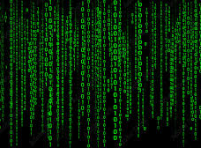
What is password hashing & cracking
Password hashing is a concept of converting passwords in to fixed-length strings, making them more difficult to crack using various methods.
Meanwhile attackers may use a method called “Password cracking” which lets them break through passwords. These are algorithms for password cracking. Some examples are brute force attacks and dictionary attacks.
These attacks have the possibility to break into a user's account and potentially gain access to sensitive information.
Notes:
4

Slide 5


What is salting
Examples with & without salting
Salting is a security technique that is used in password hashing. It adds an extra layer of protection against dictionary attacks. A salt is a randomly generated string of characters that is added to a password before hashing.
Without:
Password: password123
Hash: 534ccdsads234rfsdjihbfsihd34
With this all users with the same password will have this common hash.
With:
Password: password123
Salt: &De23%
Salted password: password123&De23%
Hash: 2badderuyit453dsgfhj21cc
With this all users with the same password will all have different hashes.
This means that if users have the same passwords the generated salt would be different. This ensures that if one user's password is cracked the other user with the same password is still safe.

Slide 6
Common Password hashing Algorithms
Bcrypt:
This is a cryptographic algorithm that is designed for password hashing.
It incorporates salting and adaptive hashing to improve the security of your passwords.
Salting ensures that even if two users have the same password, their individual hash will be different.
SHA-256:
This algorithm is part of the Secure Hash Algorithm (SHA-2) and was developed by the NSA (National Security Agency).
It produces a fixed size of 256-bit hash value for any input the user desires, ensuring integrity and consistency.
This method is commonly used for digital signatures and blockchain systems.
Notes:
6

Slide 7
Advantages & disadvantages of bcrypt & sha-256
BCRYPT
SHA-256
Advantages:
It is slower and more computationally expensive, meaning brute-force attacks are more challenging.
Bcrypts adaptability ensures it remains secure as technology advances.
Disadvantages:
It is power straining as for applications it requires high-speed performance.
There are more complex implementation compared to simpler algorithms like SHA.
Advantages
It’s fast efficient for generating hash values.
Widely supported and standardized, making it simple to use on many systems.
SHA uses a fixed-length which ensures that the hash can be easily stored and verified.
Disadvantages
Not designed for password hashing as it lacks built in salting. It is why can be vulnerable to brute-force and dictionary.

Slide 8
Common password cracking algorithms
Brute-Force:
A brute force attack involves the algorithm attempting every possible combination until the correct password was found.
This method guarantees success.
Issues arise as it can take a very long time for the password to be cracked depending on the user’s passwords complexity and length
Dictionary Attacks:
A Dictionary attack uses a precompiled list of common words a user would use as a password, hence the name dictionary to attempt to crack the user’s password.
In our project we found a file with roughly 40 thousand plus words.
The downside of this method is there is an unlimited number of words a user could use to create their password.

Slide 9
Advantages & disadvantages of brute-force & dictionary
BRUTE-FORCE
DICTIONARY
Advantage:
This method can crack any password given enough time for it to cycle through.
This method does not require any prior knowledge of the user's password meaning there isn’t a single password safe from this method given certain circumstance
Disadvantage:
It is extremely time-consuming and computationally expensive. Especially for very long and complex passwords.
It can be impractical against salted hashes and strong passwords meaning it will have a more computational cost
Advantages:
This method is faster than the previously used brute-force
This method is very simple to execute as all is needed is thousands of words in an executable file
Disadvantage:
This method is limited by the quality of the dictionary, and will not attempt to crack any passwords that are not in the dictionary
It is less effective against strong and unique passwords
This method is useless against hashed passwords

Slide 10
Practical Application
How to Use the Script:
1. Input a password.
2. Observe hash generation.
3. Watch brute-force and dictionary attack attempts.
Key Insights:
Load a high-quality word list for better dictionary attacks.
Understand the importance of password security.
Educational Value:
Demonstrates the need for strong passwords and secure hashing.

Slide 11
Overview of the Code
Main components:
Password Hashing: Secure password storage with bcrypt.
Brute-Force Cracking: Testing all possible combinations.
Dictionary Attack: Using a word list to guess passwords.
Learning Objectives:
Understand secure hashing techniques.
See cracking methods in action.
Learn about vulnerabilities in password security.

Slide 12
Code Snippet Explanation
Code Snippet
Explanation
# 1. Password Hashing with bcrypt
import bcrypt hashed_password = bcrypt.hashpw(password.encode('utf-8'), bcrypt.gensalt())
# 2. Generating SHA-256 Hash
import hashlib
def generate_sha256_hash(password):
return hashlib.sha256(password.encode()).hexdigest()
# 3. Brute-Force Cracking
from itertools import product
chars = 'abc123'
for guess in product(chars, repeat=3): print(''.join(guess))
# 4. Dictionary Attack
with open('dictionary.txt', 'r') as file:
words = file.read().splitlines()
This snippet demonstrates how to securely hash a password using bcrypt. It encodes the plaintext password, generates a unique salt, and produces an irreversible hash for secure storage.
This function creates a SHA-256 hash of a given password.
This code generates all possible combinations of the characters 'abc123' with a length of 3, simulating a brute-force attack. It systematically guesses every potential password.
This snippet loads a list of words from a dictionary file into a Python list. The dictionary attack uses these precompiled words to test potential # passwords quickly.

Slide 13
Project comparison between brute-force and dictionary
As we previously spoke about the advantages and disadvantages of each algorithm, we tested the same passwords and compared the speed between each other.
We realise that brute force takes substantially longer for it to crack the password, meanwhile dictionary is far superior if it comes to how fast it takes for it to crack
You can see that for the given word “word” it took brute force almost 15 minutes for it to crack, meanwhile it took the dictionary attack just 6 seconds.

Slide 14
Continued:
In the other hand we tested the word “crit” which even though it took brute-force over 2 minutes for it to crack. Since the word wasn’t in the dictionary, the algorithm failed and stopped attempting to crack the password.
This shows that brute force is more effective in its method and that dictionary is more efficient with its completion speed.

Slide 15
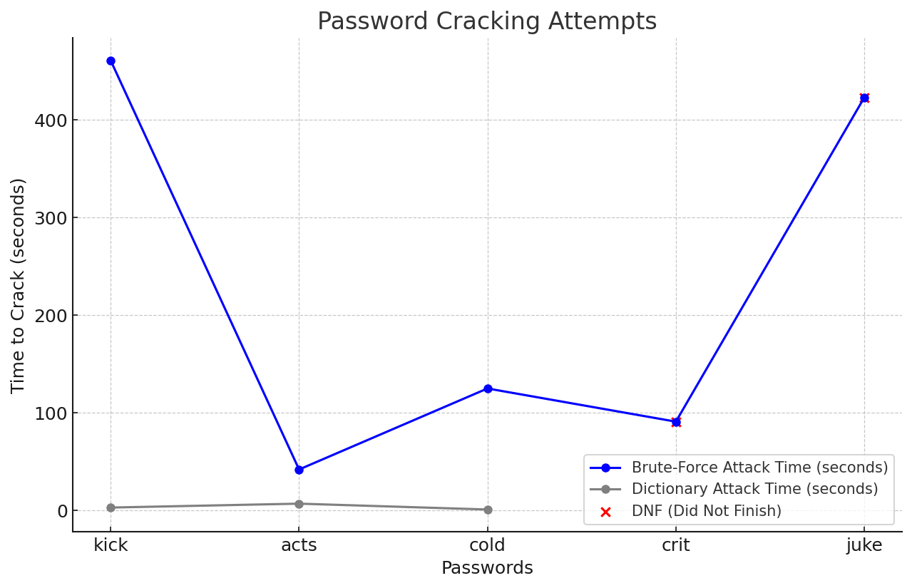
Chart of password cracking
This chart represents 5 separate words that were tested to test the speed of brute-force and dictionary attacks
From the chart we see that for some words like "kick" it took brute force over 400 seconds for it to crack the password
Meanwhile dictionary was always under 10 seconds, with its only issue being that it did not finish the cracking attempt as the word was not in the set dictionary
Overall, this comparison shows both advantages and disadvantages of each of the algorithms used in this project

Slide 16
Real-Time Visualization
Dynamic Updates:
Shows progress in brute-force and dictionary attacks.
Displays the current password being tested.
Displays time taken to crack each password
Example Code:
pbar.set_postfix_str(f"Testing: {guess}")

Slide 17
Conclusion
Summary:
Secure password hashing is essential.
Brute-force and dictionary attacks expose weak passwords.
Visualization helps understand these processes.
Final Takeaway:
Always use strong, unique passwords and secure hashing methods like bcrypt.

Slide 18

References
bcrypt Library Documentation
Python tqdm Library
NIST Digital Identity Guidelines
OWASP Password Storage Cheat Sheet
Password Cracking with Python
Python hashlib Module Documentation

